Slide 1
Cubemap
CSU0021: Computer Graphics

Slide 2
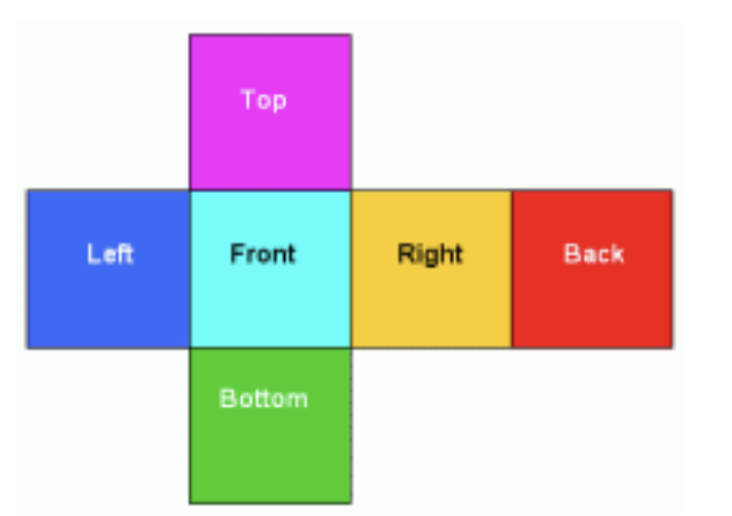
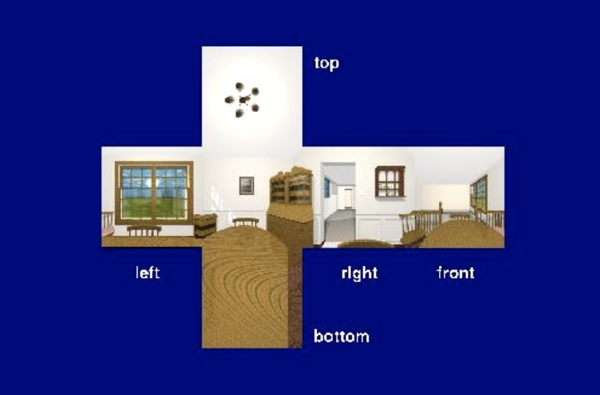
Cubic Environment Mapping (Cubemap)
Introduced by Nate Green 1986
Place the camera in the center of the environment and project it to 6 sides of a cube
Cube map consists of six 2D images

Slide 3
Cubic Environment Mapping (Cubemap)
Applications
Skybox
Environment refraction
Environment reflection
Dynamic reflection

Slide 4
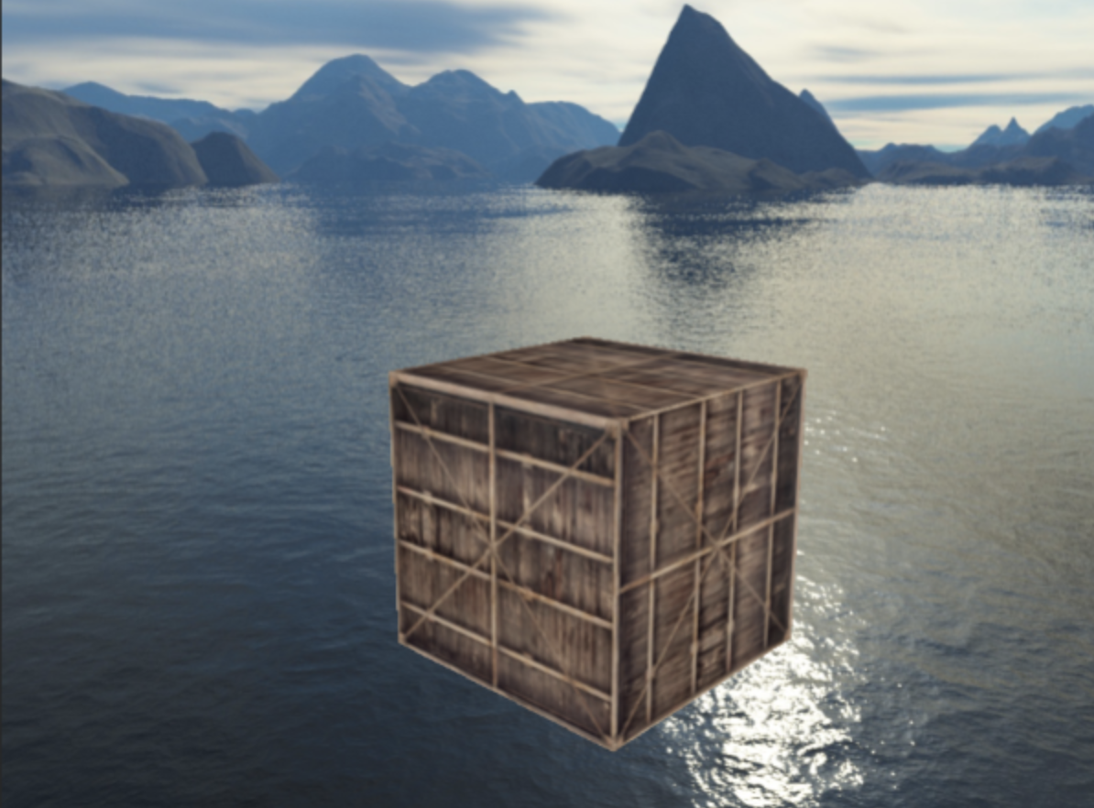
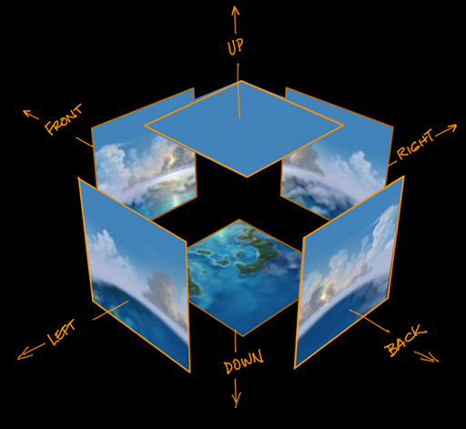
Skybox
The background comes from cube map images

Slide 5
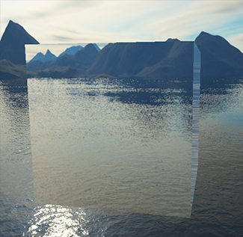
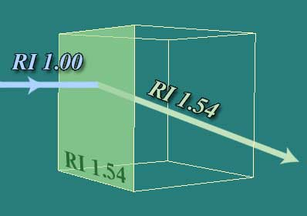
Environment Refraction

Slide 6
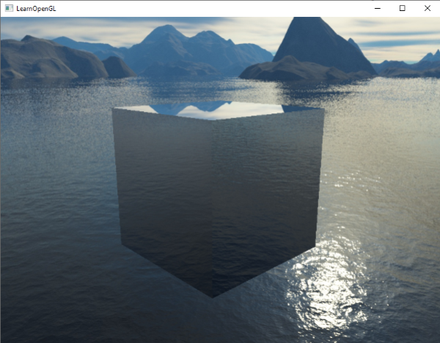
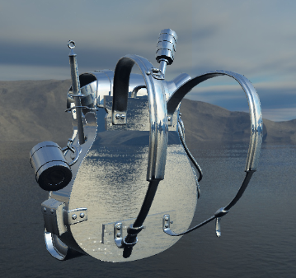
Environment Reflection

Slide 7
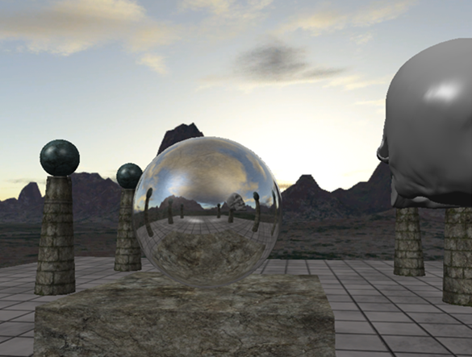
Dynamic Reflection

Slide 8
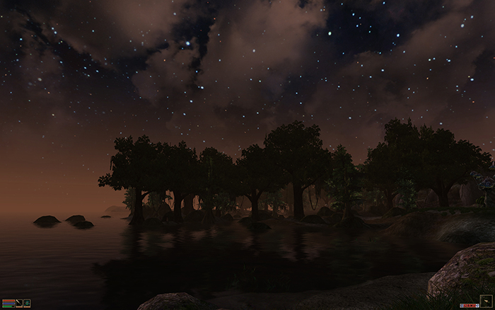
Skybox
A large cube that encompass the entire scene
Contains 6 images of a surrounding environment
Let users/players the illusion that the environment he is in is much larger than it is
Examples of skybox in video games: mountains, clouds or sky

Slide 9
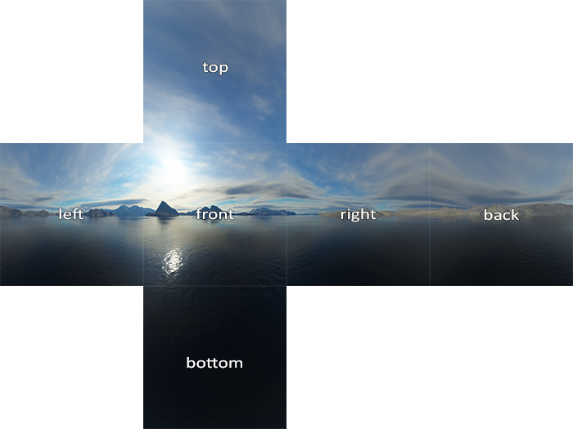
Cubemap
The skypbox comes from a cubemap
Cubemap consists of 6 images
Load the images and use them to render the background

Slide 10
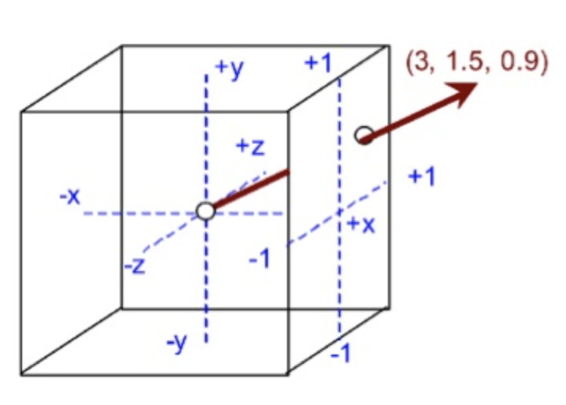
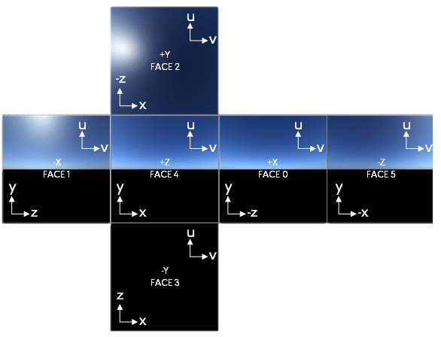
Cubemap
Cubemap is supported by WebGL
After the 6 images (cubemap) is loaded, WebGL has a special texture, cubemap texture, to handle it
You can use a vec3 to indicate a location and access a color on the cubemap
Between (+1, +1, +1) and (-1, -1, -1)

Slide 11
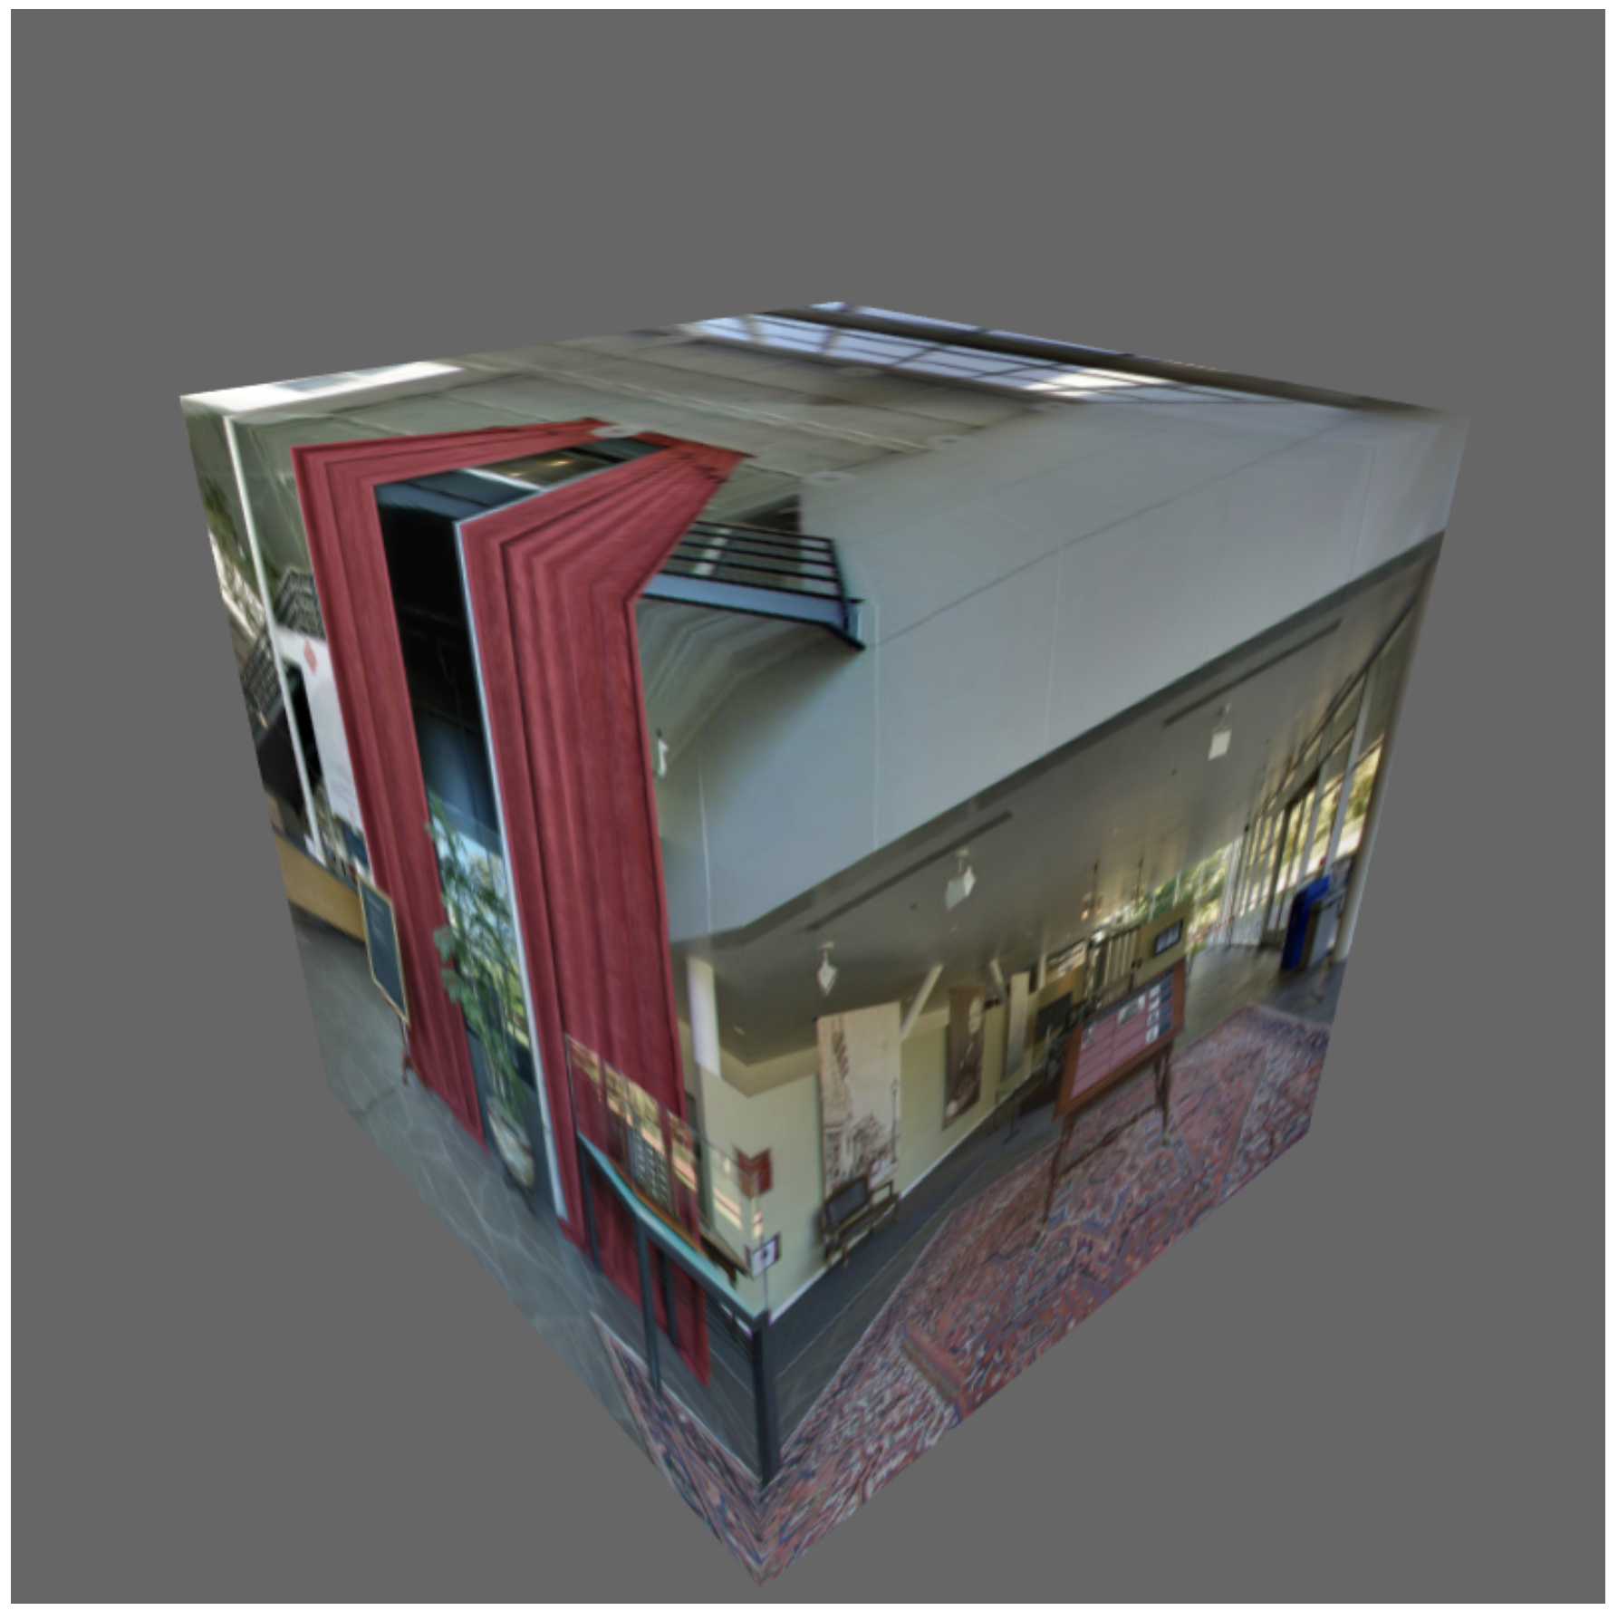
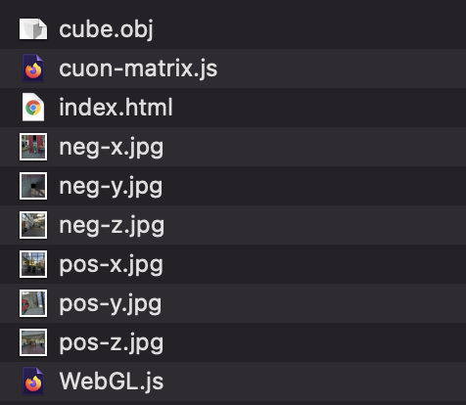
Example (Ex10-1)
Load a cubemap and use it to color a cube
Files

Slide 12
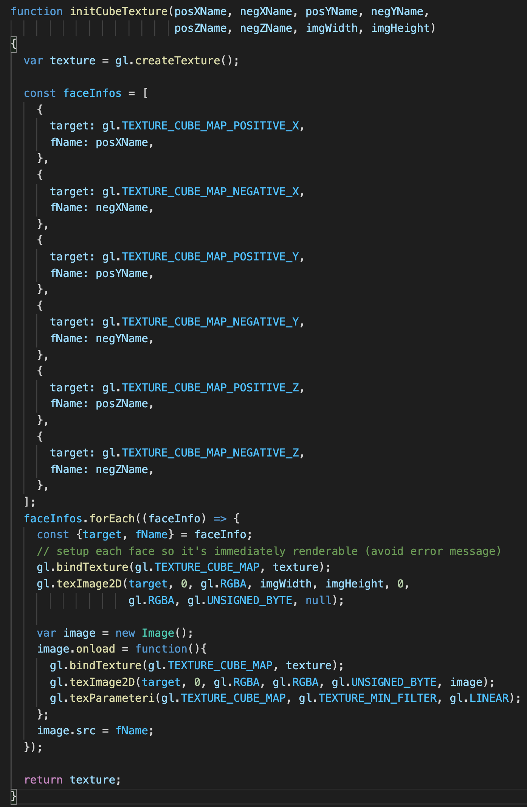
Example (Ex10-1)
initCubeTexture() in WebGL.js
Very similar to initalize a 2D texture
Steps
Create a texture buffer
Bind the buffer to “gl.TEXTURE_CUBE_MAP”
Assign a loaded image to the appropriate target (ex: gl.TEXTURE_CUBE_MAP_POSITIVE_Y)
Configurate the cubemap
gl.texParameteri()
In main()

Slide 13
Example (Ex10-1)
initCubeTexture() in WebGL.js
Very similar to initalize a 2D texture
Steps
Create a texture buffer
Bind the buffer to “gl.TEXTURE_CUBE_MAP”
Assign a loaded image to the appropriate target (ex: gl.TEXTURE_CUBE_MAP_POSITIVE_Y)
Configurate the cubemap
gl.texParameteri()
In main()

Slide 14
Example (Ex10-1)
initCubeTexture() in WebGL.js
Very similar to initalize a 2D texture
Steps
Create a texture buffer
Bind the buffer to “gl.TEXTURE_CUBE_MAP”
Assign a loaded image to the appropriate target (ex: gl.TEXTURE_CUBE_MAP_POSITIVE_Y)
Configurate the cubemap
gl.texParameteri()
In main()

Slide 15
Example (Ex10-1)
initCubeTexture() in WebGL.js
Very similar to initalize a 2D texture
Steps
Create a texture buffer
Bind the buffer to “gl.TEXTURE_CUBE_MAP”
Assign a loaded image to the appropriate target (ex: gl.TEXTURE_CUBE_MAP_POSITIVE_Y)
Configurate the cubemap
gl.texParameteri()
In main()

Slide 16
Example (Ex10-1)
initCubeTexture() in WebGL.js
Very similar to initalize a 2D texture
Steps
Create a texture buffer
Bind the buffer to “gl.TEXTURE_CUBE_MAP”
Assign a loaded image to the appropriate target (ex: gl.TEXTURE_CUBE_MAP_POSITIVE_Y)
Configurate the cubemap
gl.texParameteri()
In main()

Slide 17
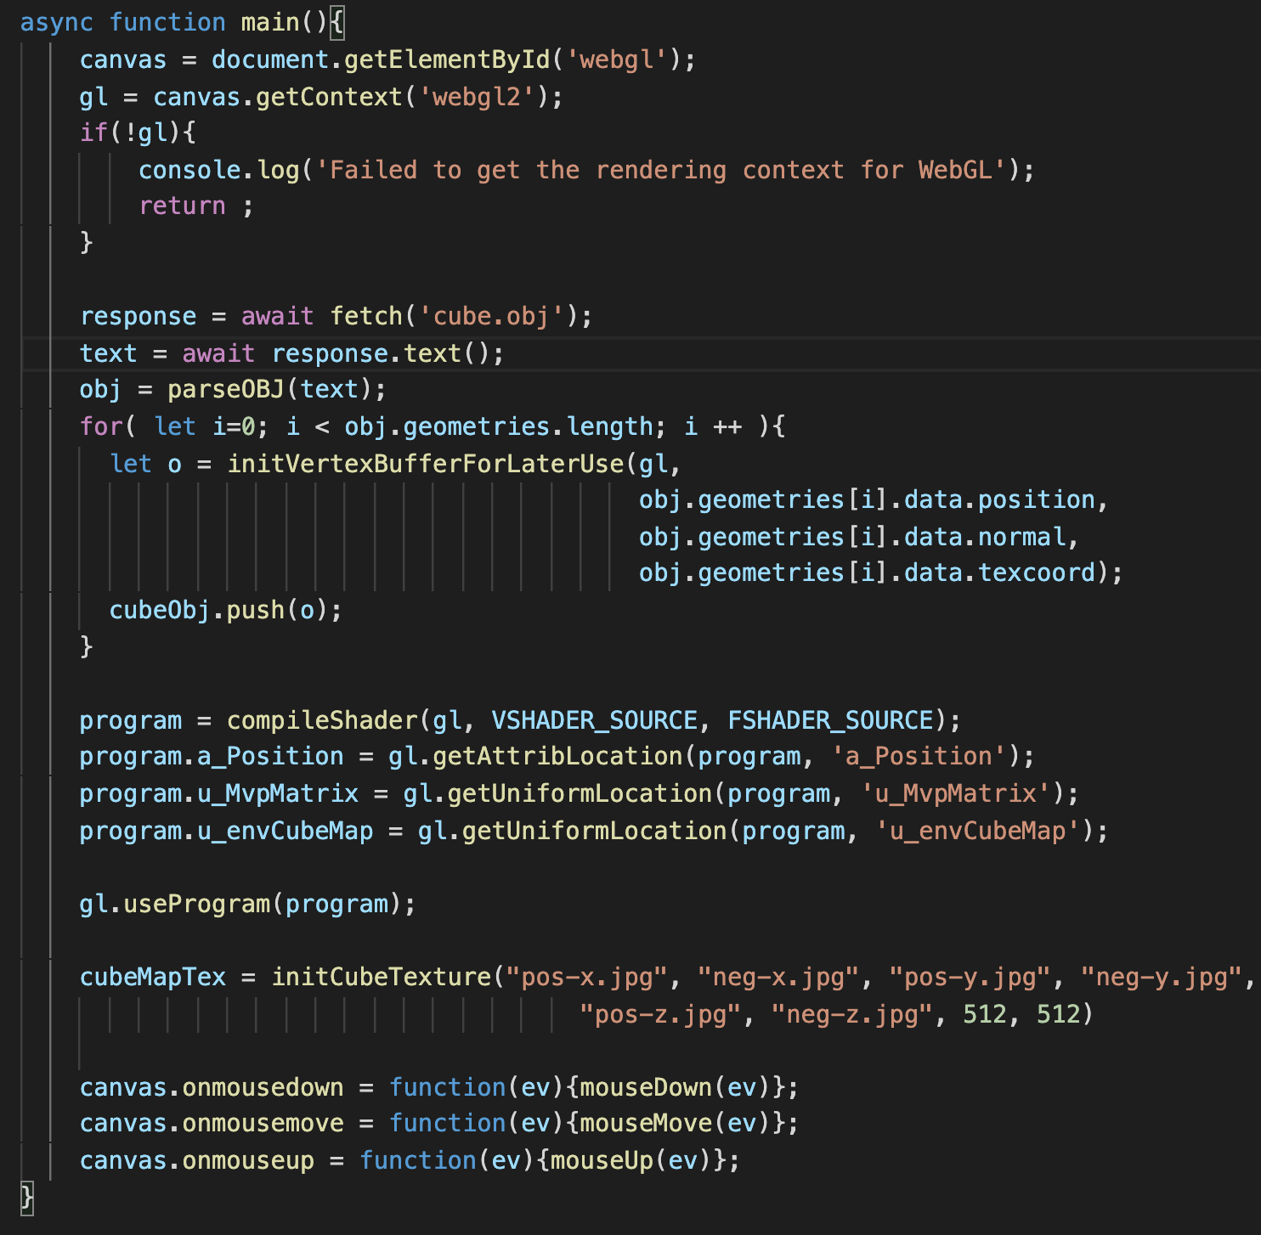
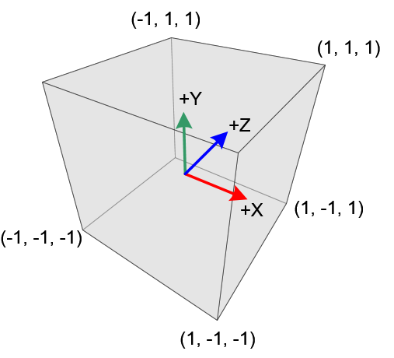
Example (Ex10-1)
main() in WebGL.js
Load a cube from obj

Slide 18
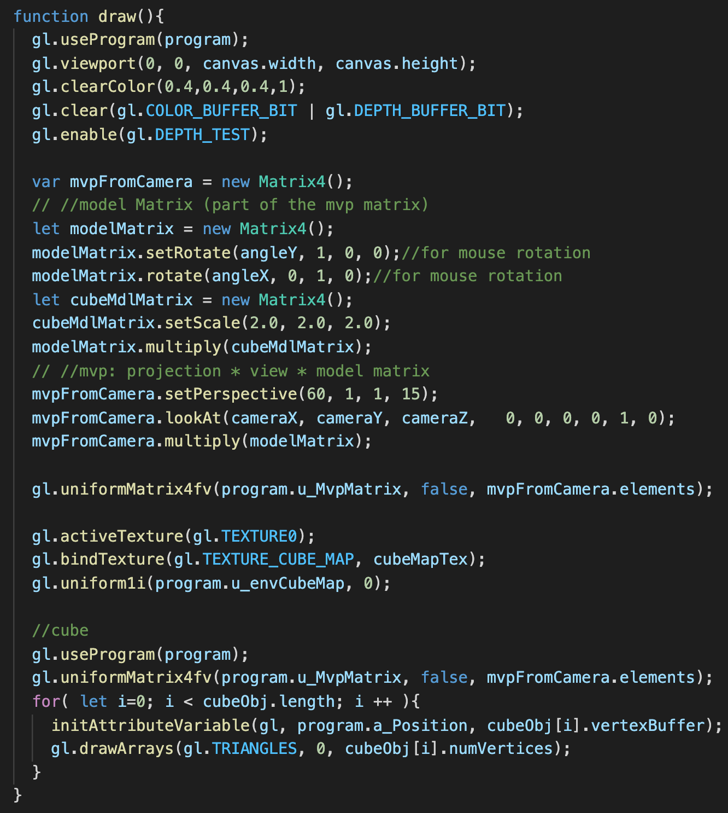
Example (Ex10-1)
Pass the cube map texture to shader
Similar to passing 2D texture
But the target is “gl.TEXTURE_CUBE_MAP”

Slide 19
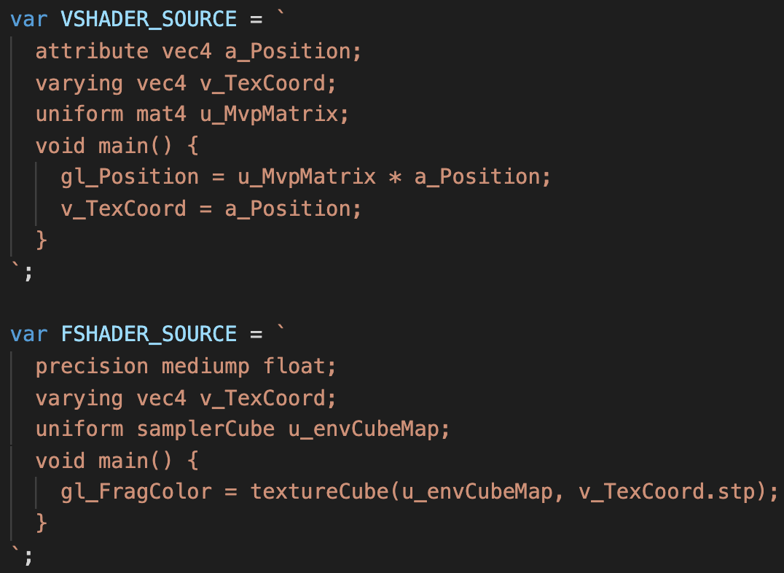
Example (Ex10-1)
Shader in WebGL.js
Variable type to represent the cubemap texture: “samplerCube”
Access color from the cube map: textureCube()

Slide 20
Try and Think (5mins)
Download the code and run
Make sure you know how to load cube map image, pass the cube map texture to shader and access color from the cube map texture
If you move the camera into the cube, what you see?
Set cameraX, cameraY, cameraZ to 0, 0 and 0.001, respectively

Slide 21
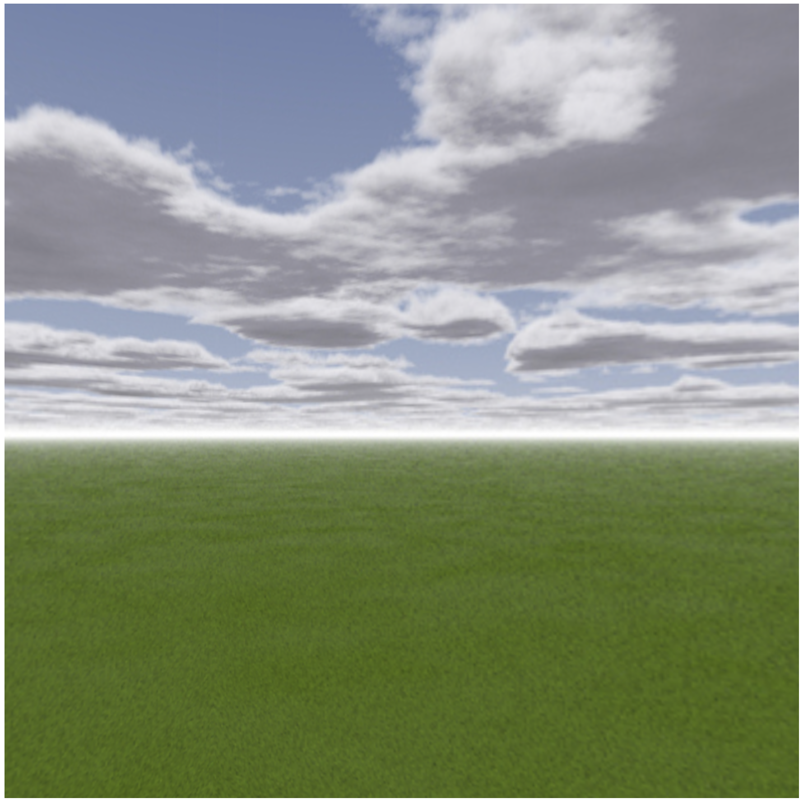
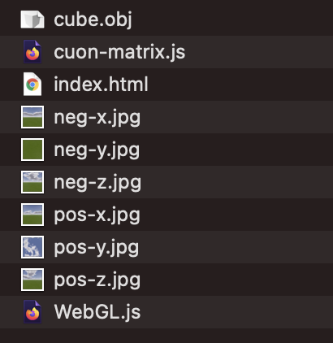
Example (Ex10-2)
Instead of using model matrix to rotate a object, we want move the camera (player) and rotate the view of the camera in the scene
Move the camera position if users press ‘w’ or ‘s’ (move forward or backward)
change the view direction if users use mouse to drag and move
Files

Slide 22
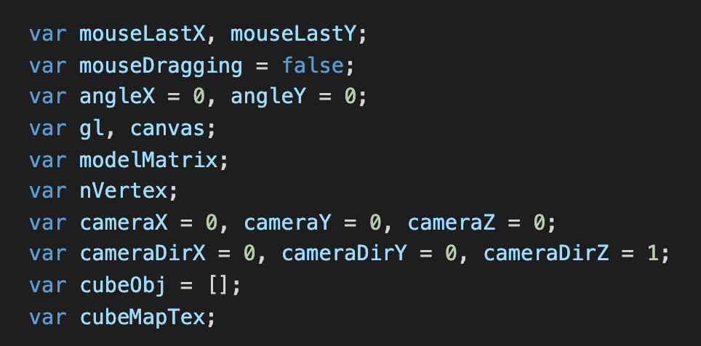
Example (Ex10-2)
I have one more variable set for view direction

Slide 23
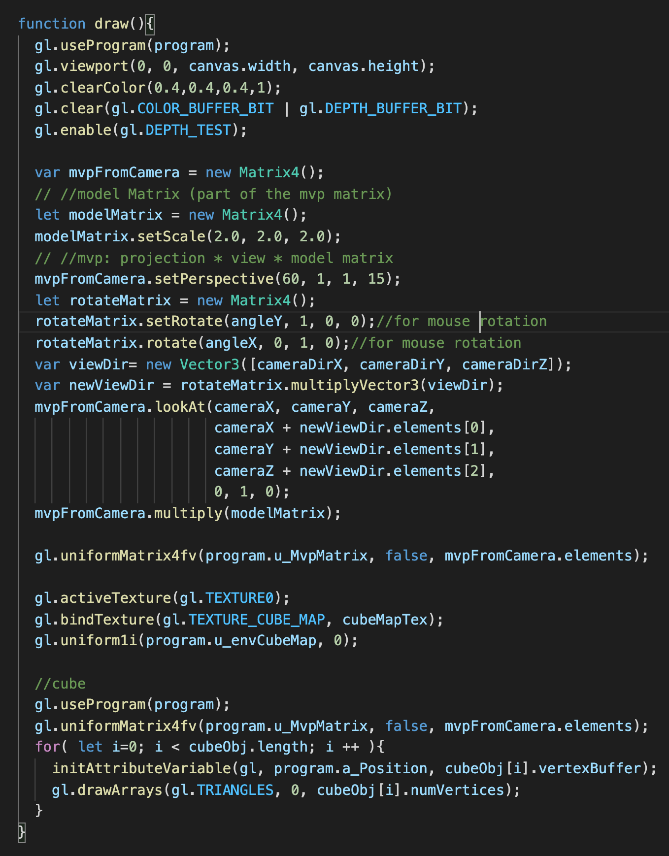
Example (Ex10-2)
draw() in WebGL.js
Now, we rotate the view direction by the information stored in “angleX” and “angleY”
Then, use the camera position and the look-at point (camera position + view direction) to set the view matrix

Slide 24
Example (Ex10-2)
draw() in WebGL.js
Now, we rotate the view direction by the information stored in “angleX” and “angleY”
Then, use the camera position and the look-at point (camera position + view direction) to set the view matrix

Slide 25
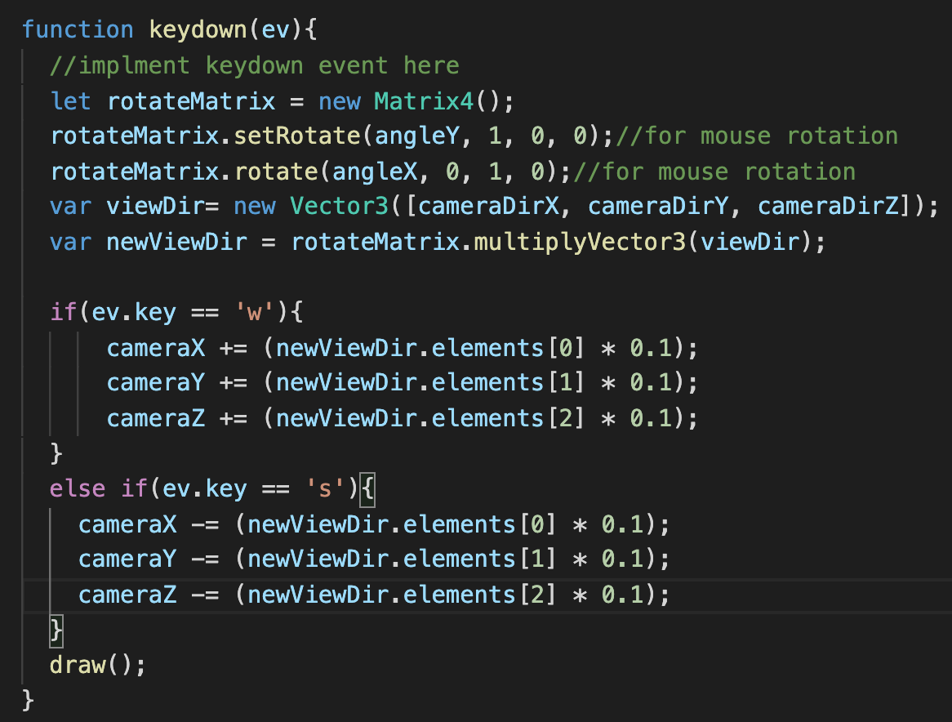
Example (Ex10-2)
keydown() in WebGL.js
Add a keyboard event to move the camera position
‘w’: move forward along the view direction
‘s’: move backward along the view direction

Slide 26
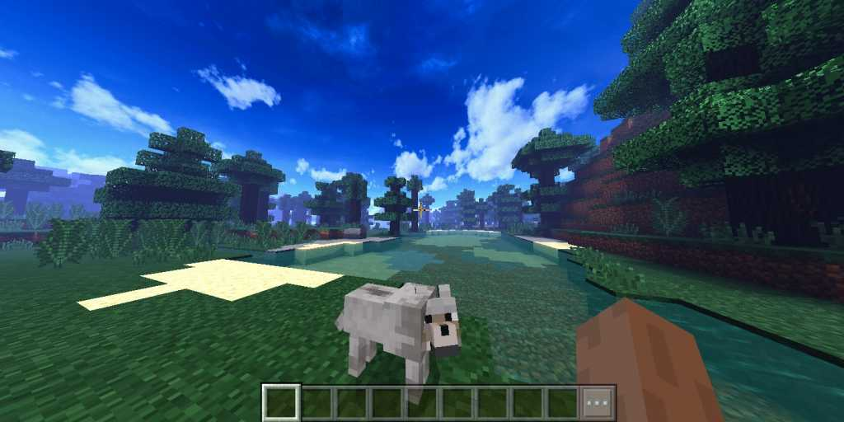
Try and Think (5mins)
Download and run the code
Keep moving, do you go out the skybox?
We usually want to keep staying in the skybox, how to solve this problem?

Slide 27

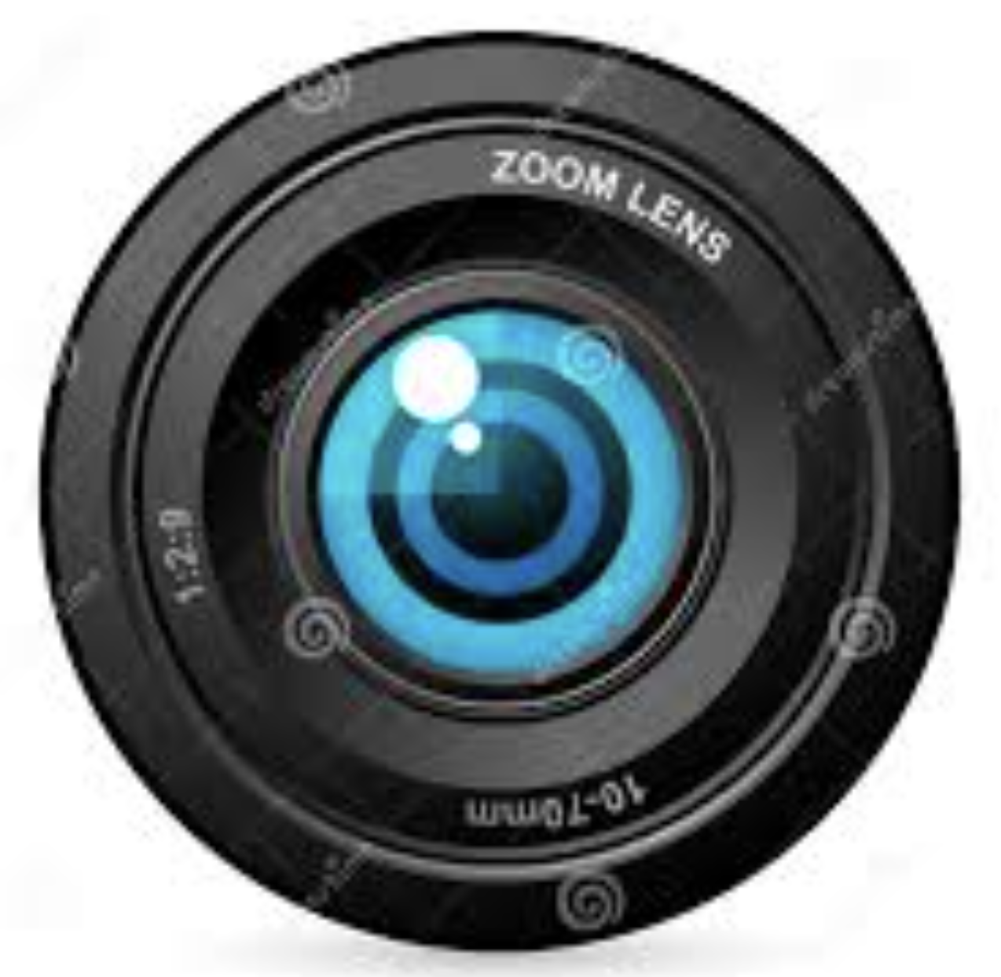
Example (Ex10-3)
We should never go out of the skybox
The environment cube supposes to stay at infinite distance
Instead of coloring an “real cube”, draw a quad which covers the whole camera view
Put the quad behind all the objects you want to render
Project the cube map to the quad
Only the rotation of the view has impact on this projection (do not consider translation)
Files
Part of the cube map (environment)
The quad

Slide 28
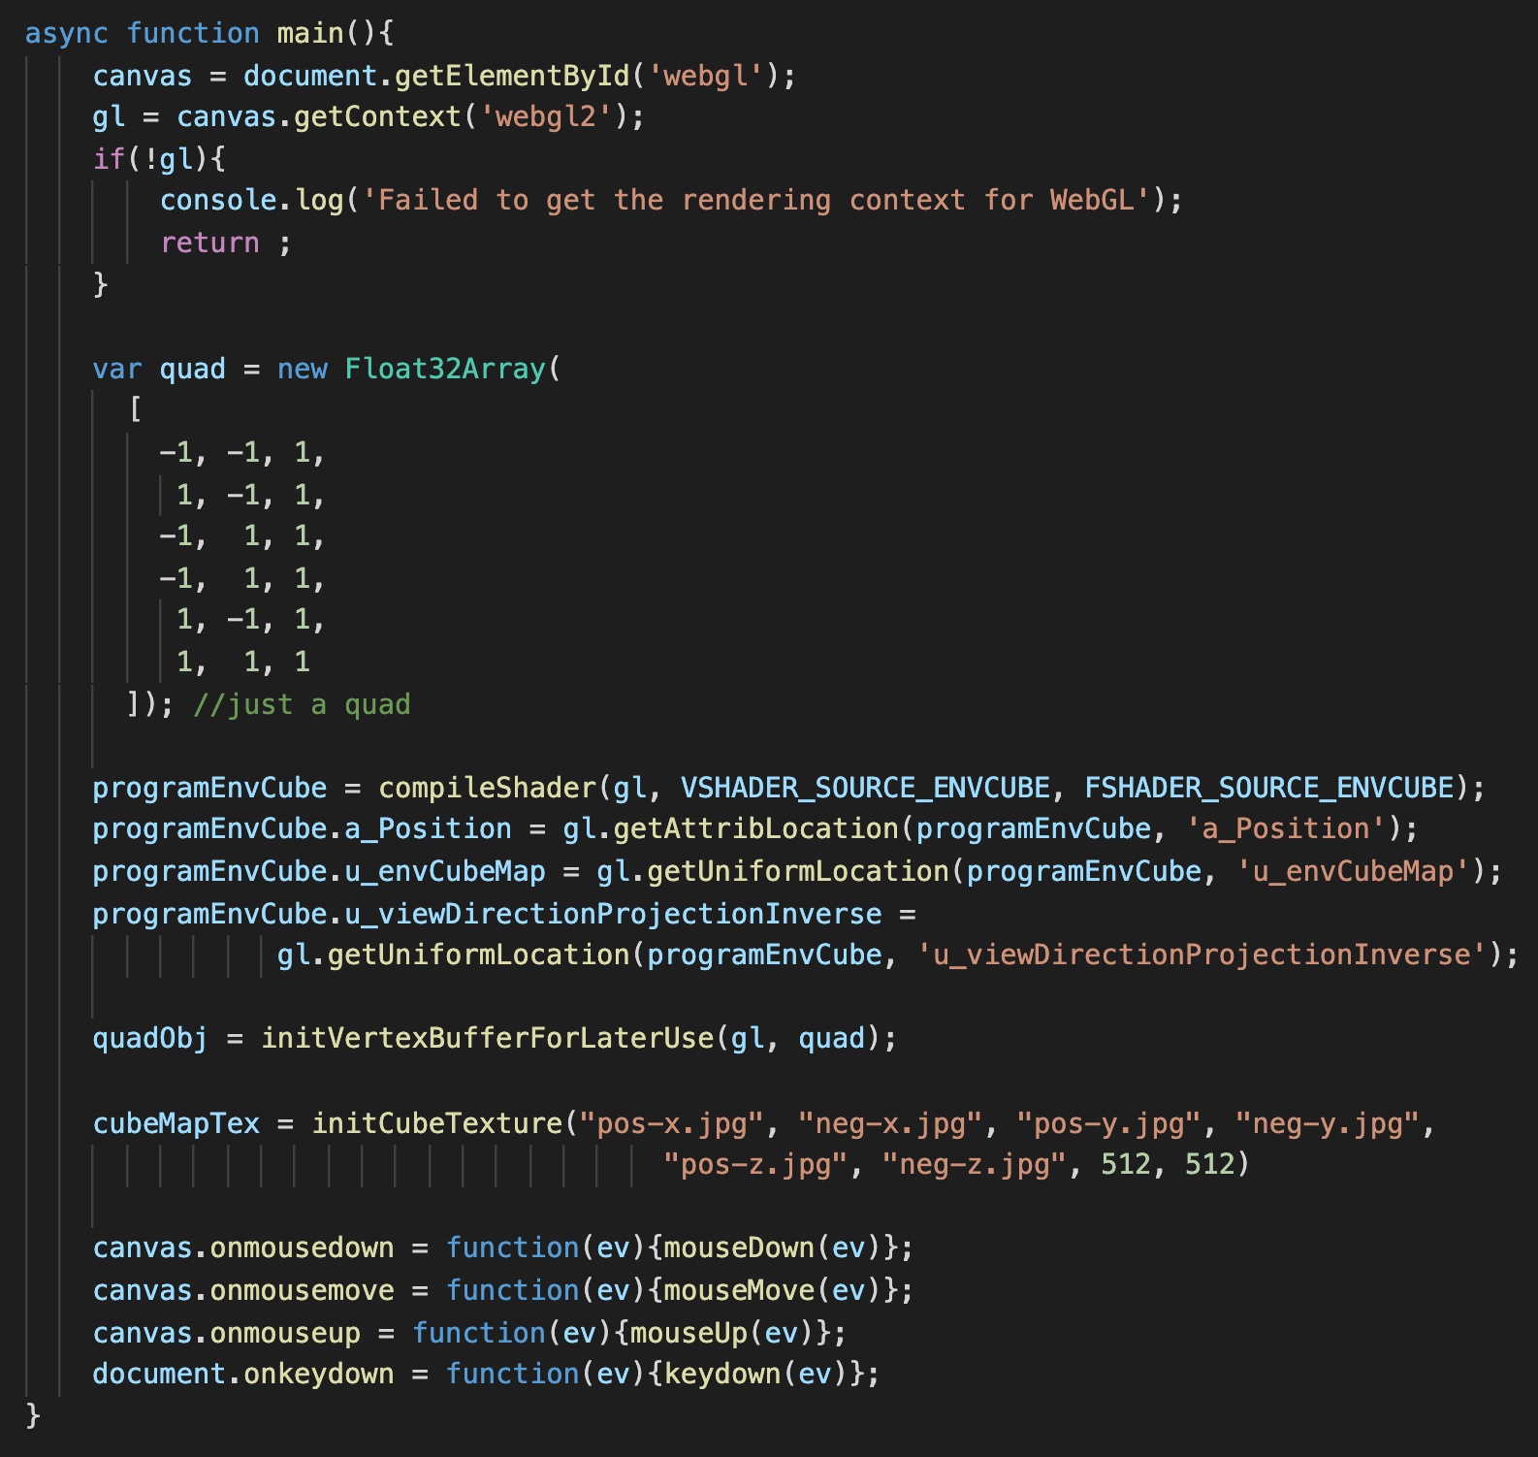
Example (Ex10-3)
In main() WebGL.js
We define a quad and the coordinate here is in “clip space”
We will NOT transform it in vertex shader
Z of this quad is 1:
we want the quad always behind all objects
Any object with z grater than 1 will be clipped out

Slide 29
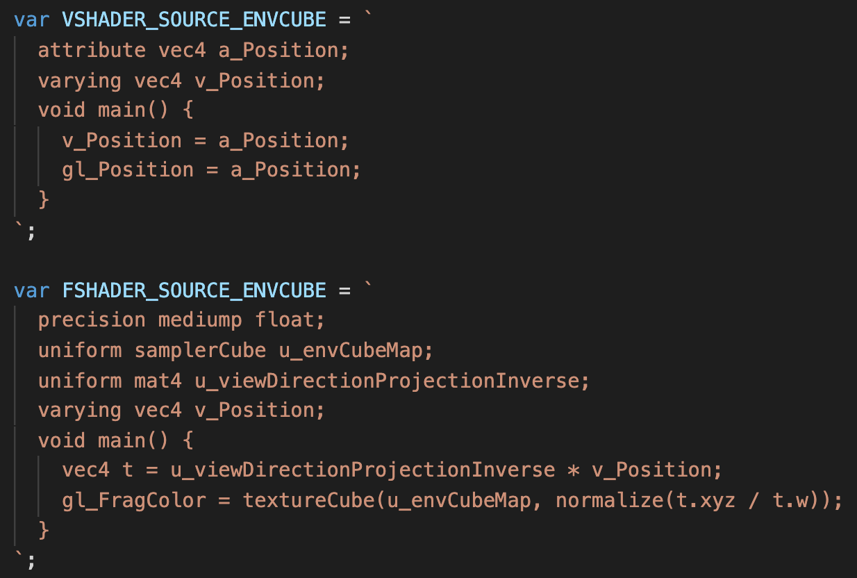
Example (Ex10-3)
Shaders in WebGL.js
The quad vertices is already in clip space, so we direct assign it to gl_Position
We also pass the quad vertices coordinates to fragment shader

Slide 30
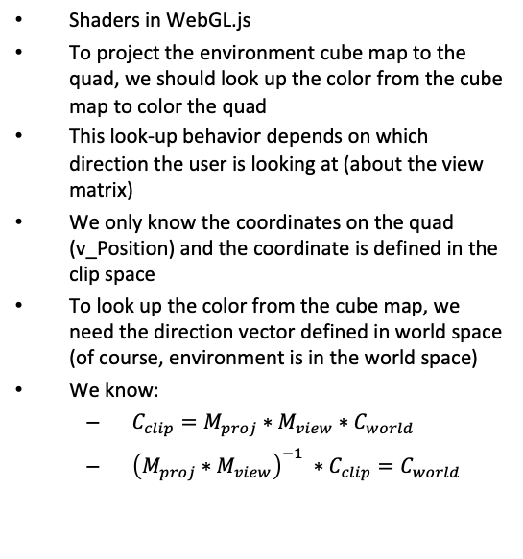
Example (Ex10-3)
Shaders in WebGL.js
To project the environment cube map to the quad, we should look up the color from the cube map to color the quad
This look-up behavior depends on which direction the user is looking at (about the view matrix)
We only know the coordinates on the quad (v_Position) and the coordinate is defined in the clip space
To look up the color from the cube map, we need the direction vector defined in world space (of course, environment is in the world space)
We know:
$C_{clip}=M_{proj}∗M_{view}∗C_{world}$
${\left(M_{proj}∗M_{view}\right)}^{−1} ∗C_{clip}=C_{world}$

Slide 31
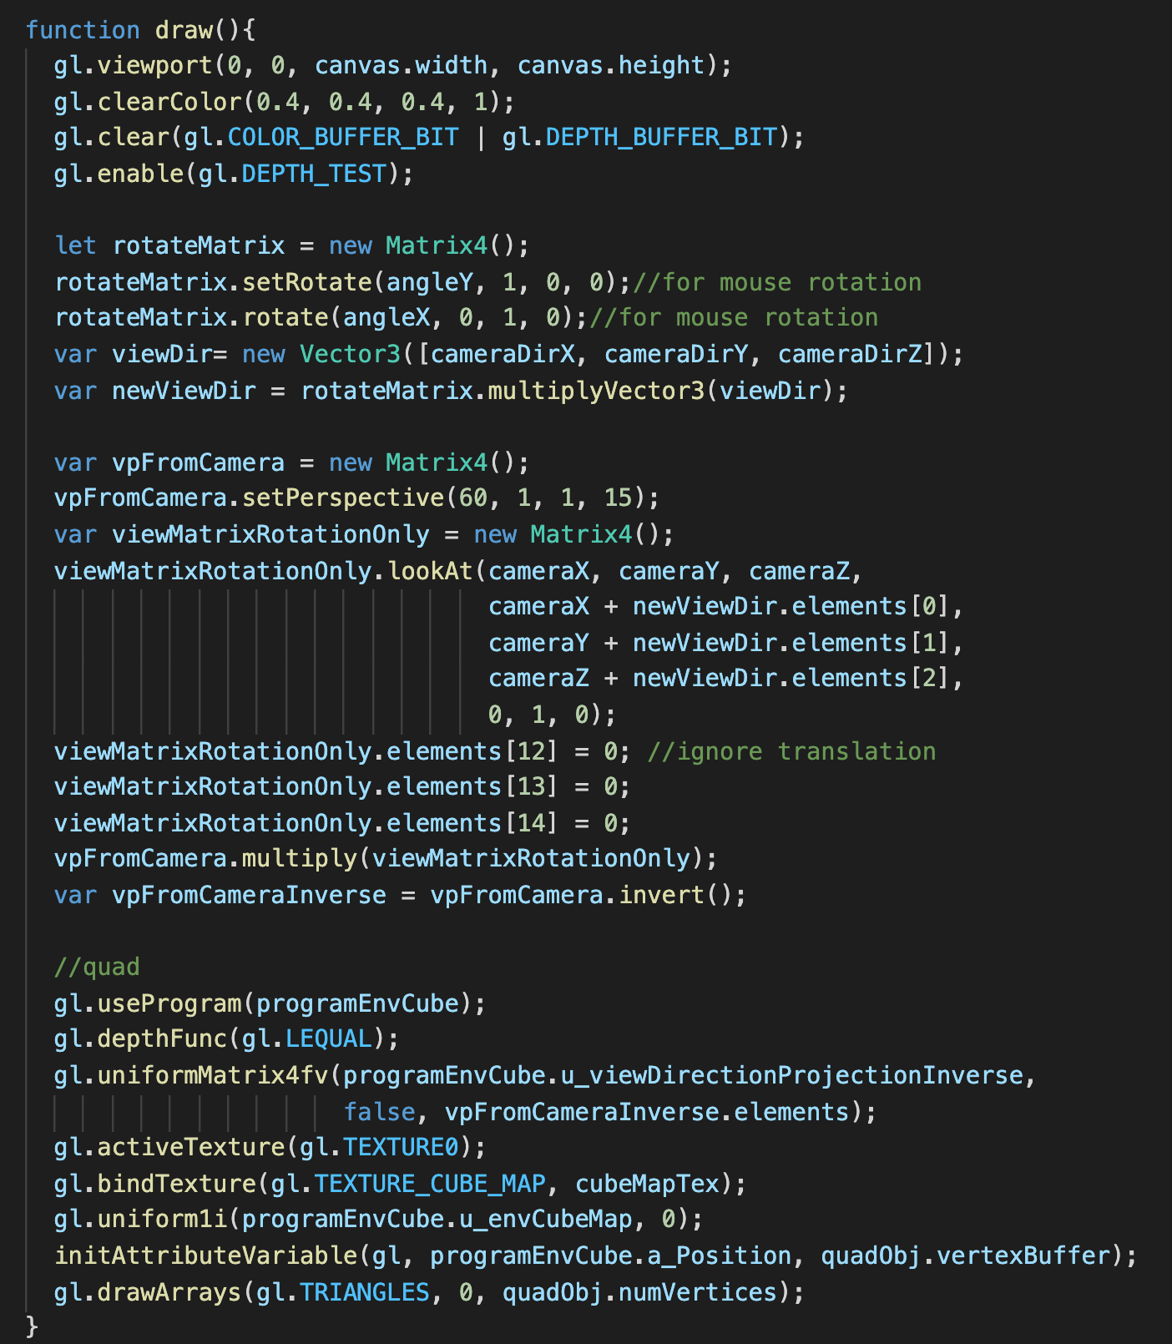
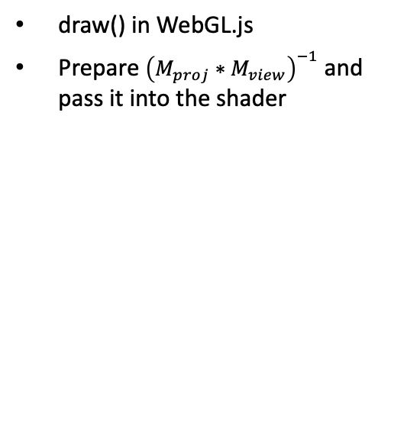
Example (Ex10-3)
draw() in WebGL.js
Prepare ${\left(M_{proj}∗M_{view}\right)}^{−1}$ and pass it into the shader

Slide 32
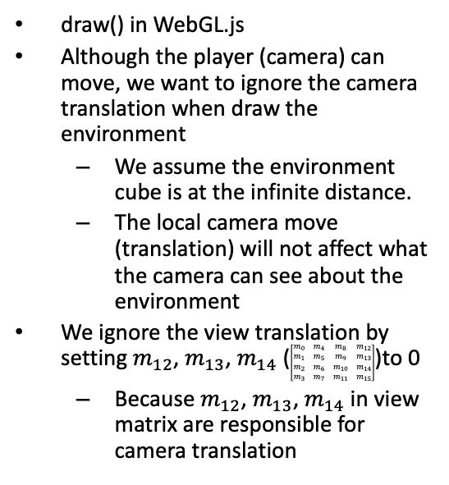
Example (Ex10-3)
draw() in WebGL.js
Although the player (camera) can move, we want to ignore the camera translation when draw the environment
We assume the environment cube is at the infinite distance.
The local camera move (translation) will not affect what the camera can see about the environment
We ignore the view translation by setting $m_{12}$, $m_{13}$, $m_{14}$ ($\left[\begin{matrix}m_{0} & m_{4} & m_{8} & m_{12} \\ m_{1} & m_{5} & m_{9} & m_{13} \\ m_{2} & m_{6} & m_{10} & m_{14} \\ m_{3} & m_{7} & m_{11} & m_{15}\end{matrix}\right]$)to 0
Because $m_{12}$, $m_{13}$, $m_{14}$ in view matrix are responsible for camera translation

Slide 33
Example (Ex10-3)
draw() in WebGL.js
gl.depthFunc()
Set what z value is possible to pass the depth buffer (in depth test)
By default, it is gl.depthFunc(gl.LESS), the value is smaller than current buffer value is possible to pass
We set the z of the quad at 1 and we want it is possible to pass the depth test. (the initial depth buffer value is 1)
gl.depthFunc(gl.LEQUAL): less ang equal
https://developer.mozilla.org/en-US/docs/Web/API/WebGLRenderingContext/depthFunc

Slide 34
Try and Think (5mins)
Download and run Ex10-3
It looks like you never move, when you press “w” and “s”. However, you move.
I use console.log() to output the camera position (x, y, z in world space) in console when you press “w” or “s”. You can check.
Think why you don’t see any change even if the camera move?
And, is this what we want?
The answer is YES.
The environment you can see should not change if you only move forward or backward (no camera rotation) because the environment background suppose to stay at infinite distance
If you add objects around you, you will realize you actually move

